Slide 1
Teacher Effectiveness Initiative Value-Added Training
Value-Added Research Center (VARC)
Notes:
This is an introductory Value-Added PowerPoint used in the Spring 2012 site visits to MN, ND, and SD for the Bush Project

Slide 2
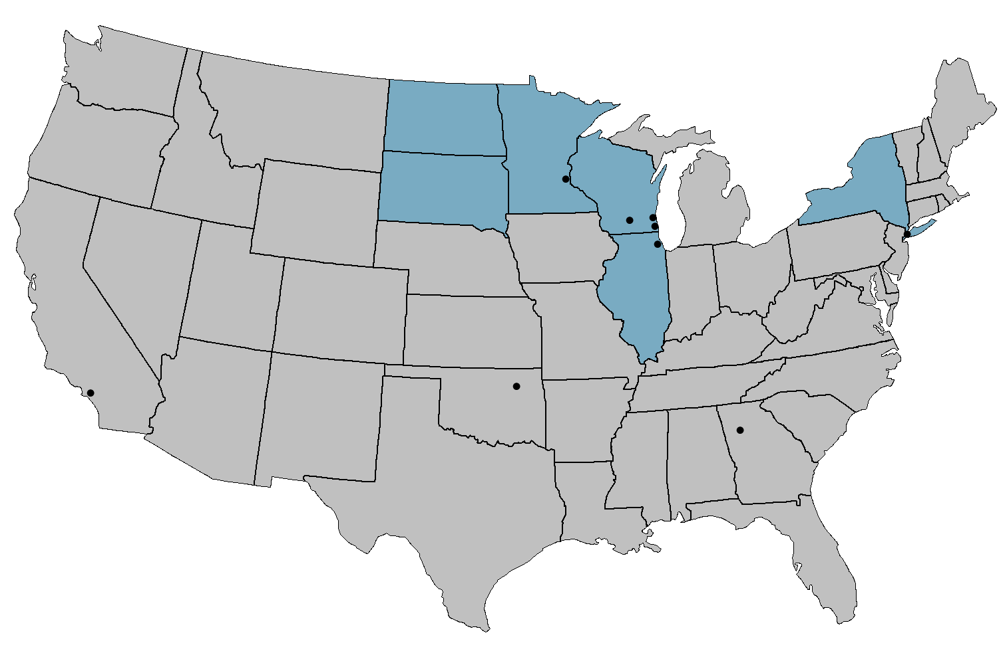
Districts and States Working with VARC
NORTH DAKOTA
MINNESOTA
Minneapolis
WISCONSIN
SOUTH DAKOTA
Milwaukee
Madison
NEW YORK
Racine
Chicago
New York City
ILLINOIS
Tulsa
Los Angeles
Atlanta
Hillsborough County
Collier County

Slide 3
Achievement and Value-Added
For the most complete picture of student and school performance, it is best to look at both Achievement and Value-Added.
This will tell you:
What students know at a point in time (Achievement)
How your school is affecting student academic growth (Value-Added)

Slide 4
The Power of Two Measures
&
Achievement
Value-Added
Compares students’ performance to a standard
Measures students’ individual academic growth longitudinally
A more complete picture of student learning
Does not factor in students’ background characteristics
Factors in students’ background characteristics outside of the school’s control
Measures students’ performance at a single point in time
Measures the impact of teachers and schools on academic growth
Critical to students’ post-secondary opportunities
Critical to ensuring all students’ future academic success
Adapted from materials created by Battelle for Kids
Notes:
Both achievement and Value-Added use student test scores, but are different ways of analyzing the data.
Achievement compares students’ performance to a standard.
Example: Jimmy is a 4th grader and there is a standard set that we want all 4th graders to achieve. Jimmy either meets or does not meet that standard when he takes the test.
Achievement does not factor in students’ background characteristics.
Example: Whether Jimmy is a boy, a girl, qualifies for SPED or not, qualifies for FRL or not (etc.), there’s a standard we want all 4th graders to achieve (high expectations for all kids).
Achievement measures students’ performance at a single point in time.
When Jimmy takes the 4th grade test, it doesn’t just measure what he learned in 4th grade. It’s measuring everything Jimmy has learned in his life up until that point. That means 3rd grade, 2nd grade, 1st grade, Kindergarten, Pre-school, knowledge from his parents & siblings, things he learned on PBS and online, etc.
Note: Keep in mind fall testing. If the test is a fall test, the 4th grade version would not include what Jimmy learned in 4th grade.
Achievement is critical to students’ post-secondary opportunities.
Example: We want to know along the way if Jimmy is on track to achieve at an appropriate “college and career ready” level of achievement by graduation time.
There’s another way to analyze this data to answer different questions.
When the question is not about the student, but instead is about the effectiveness of educators, we need to consider additional information.
To start, Value-Added measures students’ individual academic growth longitudinally.
Example: Jimmy takes a test at the end of 3rd grade and another test at the end of 4th grade. We can measure the growth that occurred between those two tests to determine how much Jimmy grew academically during the 4th grade school year.
Note: Keep in mind fall testing. If the test is a fall test, the growth would be from the beginning of 3rd grade to the beginning of 4th grade, which would translate to academic growth during the 3rd grade school year.
Value-Added factors in students’ background characteristics outside of the school’s control.
Example: We know that different kids bring different resources with them to the classroom. With Value-Added analysis, our goal is to use real data to determine what external factors have an effect on student growth so we can account for those factors. An example is special education. We would use real data to determine if SPED students grew faster or slower than non-SPED students and incorporate that into the analysis. When evaluating a particular teachers, we would then be able to fairly evaluate the academic growth of his or her students regardless of the SPED makeup of the classroom.
Value-Added measures the impact of teachers and schools on academic growth.
Example: By controlling for things like SPED, we can account for these factors to isolate the impact of educators on the academic growth of students.
Value-Added is critical to ensuring all students’ future academic success.
Example: Consider the incentive under achievement models to teach to the “bubble kids”
Bubble Kids – Under most proficiency models, there is a relatively arbitrary line that students need to pass for a school to get credit for in an accountability system.
Think about the incentive structure here – with limited time and resources, these systems are set up to emphasize getting kids above this mark.
If a kid is 3 grade levels behind at the beginning of the year and a teacher gets the kid to 1 grade level behind by the end of the year, this teacher gets no credit in a traditional proficiency model.
If a kid is 1 grade level ahead at the beginning of the year and a teacher gets the kid to 3 grade levels ahead by the end of the year, the teacher gets no additional credit since the kid was already above the line to start with.
With a Value-Added model, you get credit for moving a kid in scale score points rather than moving proficiency buckets. This aligns with the goals of education – taking kids at far as possible given their starting knowledge.

Slide 5
VARC Design Process: Continuous Improvement
Objective
Model Co-Build
Output
Stakeholder Feedback
Valid and fair comparisons of teachers serving different student populations
Productivity estimates (contribution to student academic growth)
New objectives
Model refinement
Full disclosure: no black-box
Model informed by technical and consequential validity
Data formatting
Notes:
This is an alternative to the “Objective Design Output” slide that’s more user friendly and emphasizes that this is a process
A value-added model (VAM) is a quasi-experimental statistical model that yields estimates of the contribution of schools, classrooms, teachers, or other educational units to student achievement, controlling for non-school sources of student achievement growth, including prior student achievement and student and family characteristics.
A VAM produces estimates of productivity under the counterfactual assumption that all schools serve the same group of students. This facilitates apples-to-apples school comparisons rather than apples-to-oranges comparisons.
The objective is to facilitate valid and fair comparisons of productivity with respect to student outcomes, given that schools may serve very different student populations.

Slide 6
The Oak Tree Analogy
Notes:
This presentation is the most popular and successful introduction to Value-Added analysis that VARC has produced.
Sean feels this is almost always an appropriate analogy to present.
For more technical or experienced audiences, this can serve as an example of how to explain Value-Added modeling to less well versed audiences.
There is also a “short version” of this presentation on workspace for a condensed presentation of this content.

Slide 7
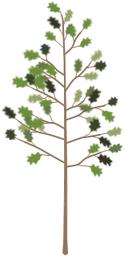
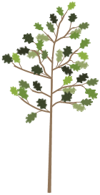
The Oak Tree Analogy
Notes:
This Oak Tree Analogy was created to introduce the concept of value added calculations. It is not in the education context in an attempt to keep this overview of the theory of value added separate from details specific to its use in education.

Slide 8
Explaining Value-Added by Evaluating Gardener Performance
For the past year, these gardeners have been tending to their oak trees trying to maximize the height of the trees.
Gardener A
Gardener B
Notes:
In this analogy, we will be explaining the concept of value added by evaluating the performance of two gardeners.
For the past year, these gardeners have been tending to their oak trees trying to maximize the height of the trees. Each gardener used a variety of strategies to help their own tree grow. We want to evaluate which of these two gardeners was more successful with their strategies.

Slide 9
Method 1: Measure the Height of the Trees Today (One Year After the Gardeners Began)
Using this method, Gardener B is the more effective gardener.
This method is analogous to using an Achievement Model.
Gardener A
72 in.
Gardener B
61 in.
Notes:
To measure the performance of the gardeners, we will measure the height of the trees today, 1 year after they began tending to the trees.
With a height of 61 inches for Oak Tree A and 72 inches for Oak Tree B, we find Gardener B to be the better gardener.
This method is analogous to using an achievement Model to evaluate performance.

Slide 10
Pause and Reflect
How is this similar to how schools have been evaluated in the past?
What information is missing from our gardener evaluation?
Notes:
Audience participation:
Evaluating the effectiveness of the gardeners based on ending height of the trees is like evaluating schools or teachers based on ending attainment/achievement of students.
Under No Child Left Behind, schools and teachers serving high achieving students were at an advantage. Generally, rich suburban schools and teachers systematically were higher rated than schools in poorer urban environments. This has more to do with the student populations than the effectiveness of the schools.
Keep in mind audience suggestions about what is missing can fall into things within or outside of the gardeners’ control.
If something like “fertilizer” is suggested, keep in mind that the gardeners have control over that factor. If fertilizer (or something to that effect) is mentioned, bring up the distinction on the “What about factors outside the gardener’s influence?” slide.
Fertilizer is a strategy we’re trying to measure rather than an outside factor we want to control for.

Slide 11
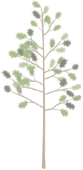
This Achievement Result is not the Whole Story
We need to find the starting height for each tree in order to more fairly evaluate each gardener’s performance during the past year.
Gardener A
72 in.
Gardener B
61 in.
52 in.
47 in.
Oak A
Age 3
(1 year ago)
Oak A
Age 4
(Today)
Oak B
Age 3
(1 year ago)
Oak B
Age 4
(Today)
Notes:
…but this achievement result does not tell the whole story.
These gardeners did not start with acorns. The trees are 4 years old at this point in time.
We need to find the starting height for each tree in order to more fairly evaluate each gardener’s performance during the past year.
Looking back at our yearly record, we can see that the trees were much shorter last year.

Slide 12
Method 2: Compare Starting Height to Ending Height
Oak B had more growth this year, so Gardener B is the more effective gardener.
This is analogous to a Simple Growth Model, also called Gain.
Gardener A
+20 in.
72 in.
Gardener B
+14 in.
61 in.
52 in.
47 in.
Oak A
Age 3
(1 year ago)
Oak A
Age 4
(Today)
Oak B
Age 3
(1 year ago)
Oak B
Age 4
(Today)
Notes:
We can compare the height of the trees one year ago to the height today.
By finding the difference between these heights, we can determine how many inches the trees grew during the year of gardener’s care.
By using this method, Gardener A’s tree grew 14 inches while Gardener B’s tree grew 20 inches. Oak B had more growth this year, so Gardener B is the better gardener.
This is analogous to using a Simple Growth Model, also called Gain.

Slide 13
What About Factors Outside the Gardener’s Influence?
This is an “apples to oranges” comparison.
For our oak tree example, three environmental factors we will examine are: Rainfall, Soil Richness, and Temperature.
Gardener A
Gardener B
Notes:
But this Simple Growth result does not tell the whole story either.
Although we know how many inches the trees grew during this year, we do not yet know how much of this growth was due to the strategies used by the gardeners themselves.
This is an “apples to oranges” comparison.
If we really want to fairly evaluate the gardeners, we need to take into account other factors that influenced the growth of the trees.
For our oak tree example, three environmental factors we will examine are: Rainfall, Soil Richness, and Temperature.

Slide 14
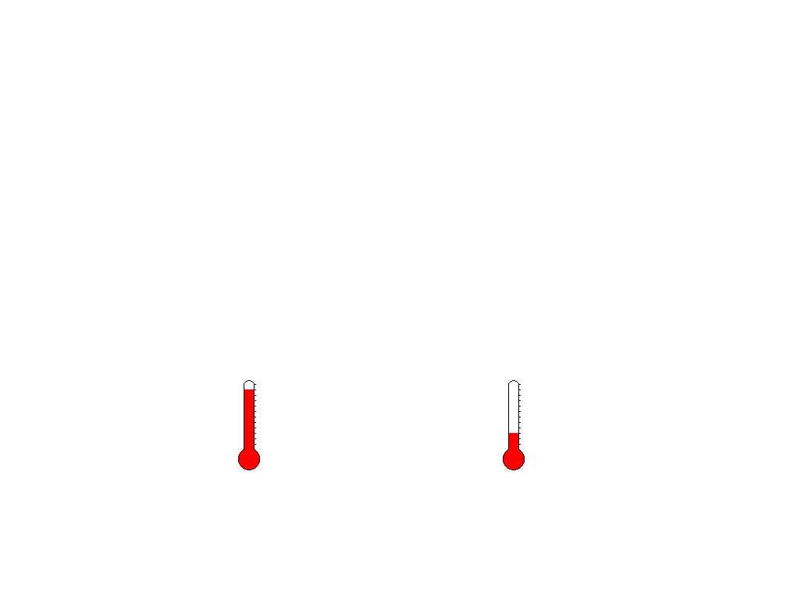
External condition | Oak Tree A | Oak Tree B
Rainfall amount
Soil richness
Temperature
High Low
Low High
High Low
Gardener A
Gardener B
Notes:
Based on the data for our trees, we can see what kind of external conditions our two trees experienced during the last year.
Oak Tree A was in a region with High rainfall while Oak Tree B experienced Low rainfall.
Oak Tree A had low soil richness while Oak Tree B has high soil richness.
Oak Tree A had high temperature while Oak Tree B had low temperature.

Slide 15
How Much Did These External Factors Affect Growth?
We need to analyze real data from the region to predict growth for these trees.
We compare the actual height of the trees to their predicted heights to determine if the gardener’s effect was above or below average.
Gardener A
Gardener B
Notes:
We can use this information to calculate a predicted height for each tree today if it was being cared for by an average gardener in the area.
We examine all oaks in the region to find an average height improvement for trees.
We adjust this prediction for the effect of each tree’s environmental conditions.
We compare the actual height of the trees to their predicted heights to determine if the gardener’s effect was above or below average.

Slide 16
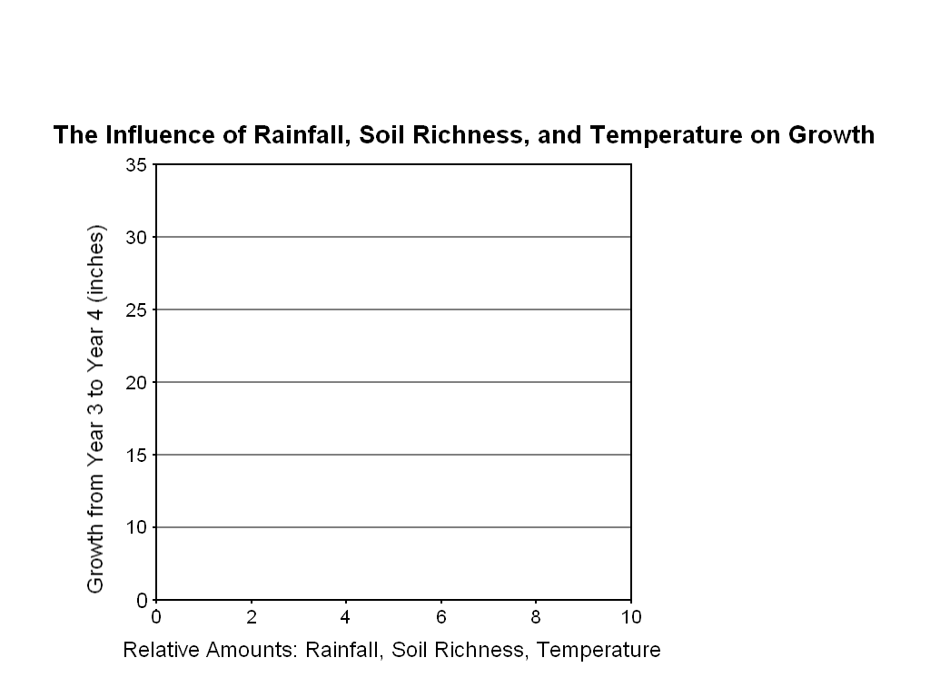
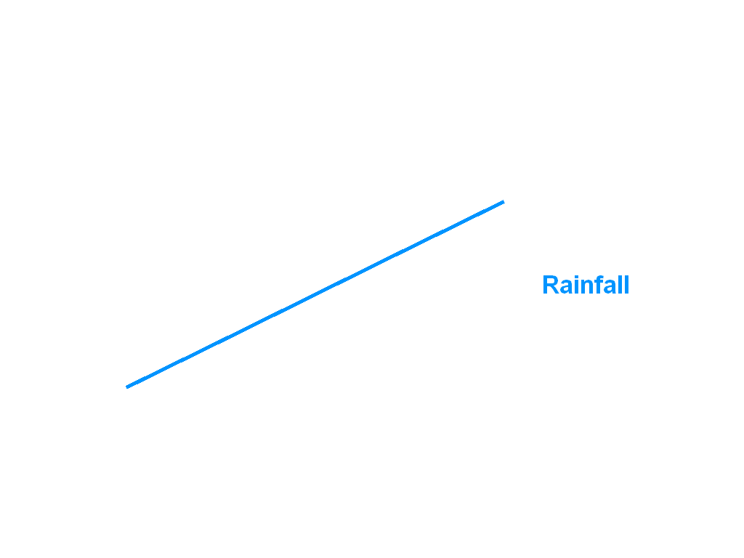
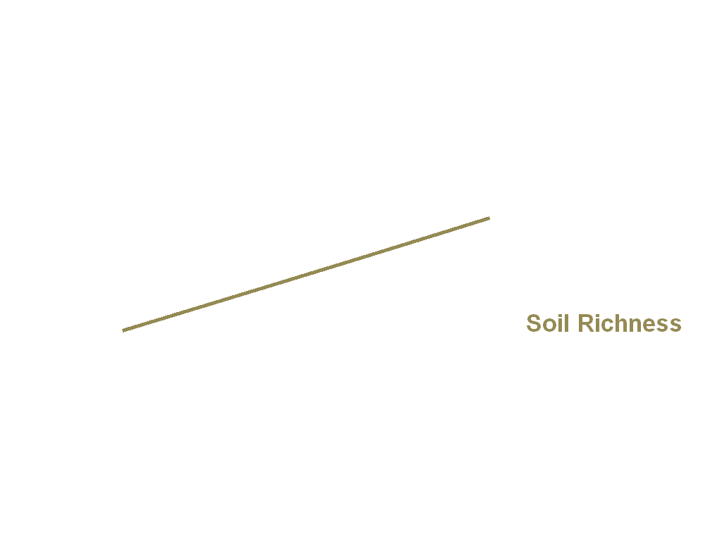
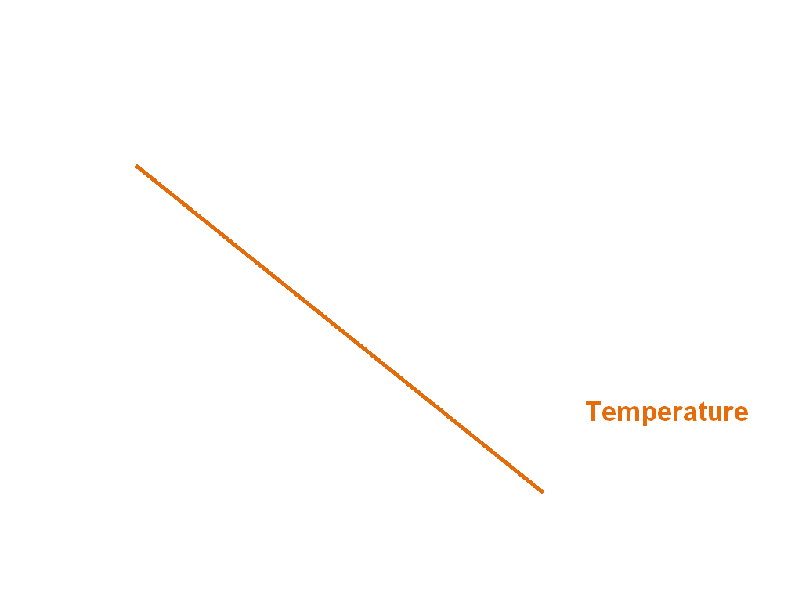
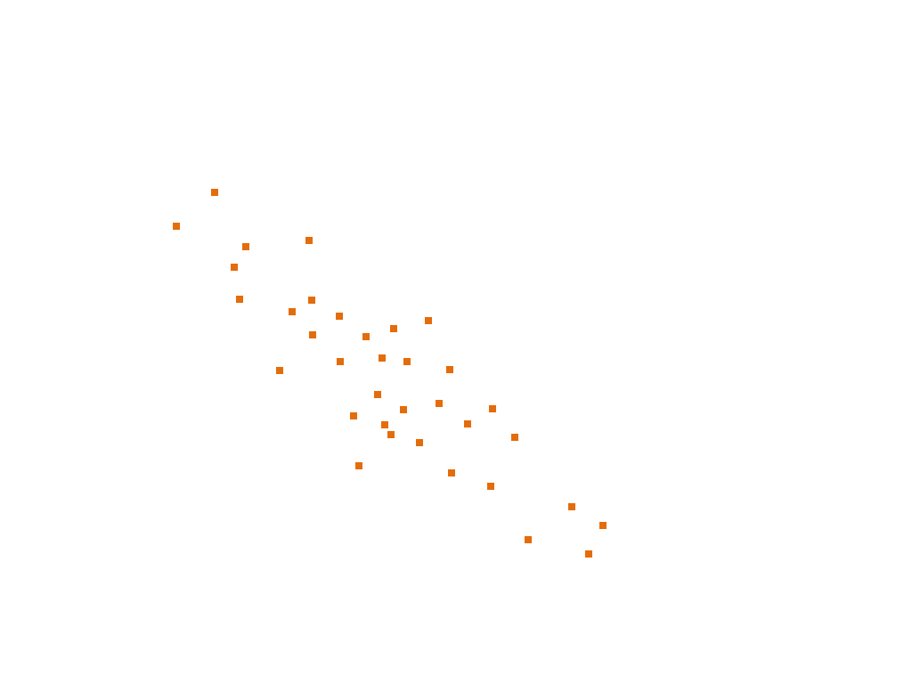
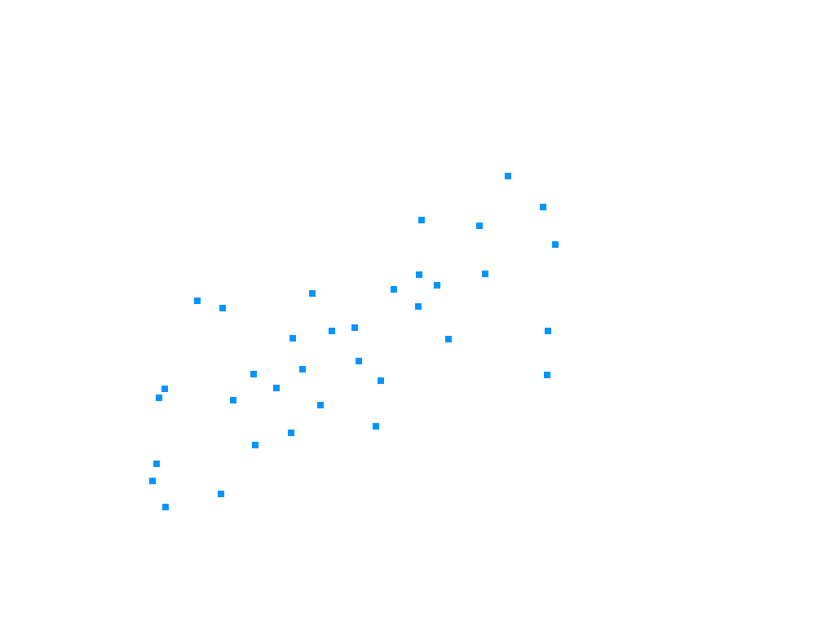
In order to find the impact of rainfall, soil richness, and temperature, we will plot the growth of each individual oak in the region compared to its environmental conditions.
Notes:
In order to find the impact of rainfall, soil richness, and temperature, we will plot the growth of each individual oak in the region compared to its environmental conditions.
On the x-axis, we plot the relative amount of each environmental condition. On the y-axis, we plot how much each tree grew from year 3 to year 4.
Each dot represents a single oak tree in the area. By calculating an average line through the data, we can determine a trend for each environmental factor.
From the data we collected for our region, we find that more rainfall and higher soil richness contributed positively to growth. Higher temperatures contributed negatively to growth.
Keep in mind: this is a stylized example of using “real data” to find out how much these factors influence growth. In reality, VARC uses a multivariate linear regression model to determine the effect of external factors.

Slide 17
Calculating Our Prediction Adjustments Based on Real Data
Rainfall | Low | Medium | High
Growth in inches relative to the average | -5 | -2 | +3
Soil Richness | Low | Medium | High
Growth in inches relative to the average | -3 | -1 | +2
Temperature | Low | Medium | High
Growth in inches relative to the average | +5 | -3 | -8
Notes:
Now that we have identified growth trends for each of these environmental factors, we need to convert them into a form usable for our predictions.
We can summarize our trend information by determining a numerical adjustment based on High, Medium, and Low amount of each environmental condition.
For example, based on our data, we found that oak trees that experienced low rainfall tended to have 5 fewer inches of growth compared to the average growth of oak trees in the region.
Trees with medium rainfall tended to have 2 fewer inches of growth compared to the average. Trees with high rainfall tended to have 3 more inches of growth compared to the average.
We calculate these numerical adjustments for all environmental conditions to summarize the trends from the data.
Now we can go back to Oak A and Oak B to adjust for their growing conditions.

Slide 18
Make Initial Prediction for the Trees Based on Starting Height
Next, we will refine out prediction based on the growing conditions for each tree. When we are done, we will have an “apples to apples” comparison of the gardeners’ effect.
Gardener A
72 in.
Gardener B
67 in.
52 in.
47 in.
+20 Average
+20 Average
Oak A
Age 3
(1 year ago)
Oak A
Prediction
Oak B
Age 3
(1 year ago)
Oak B
Prediction
Notes:
To make our initial prediction, we use the average height improvement for all trees.
Based on our data, the average improvement for oak trees in the region was 20 inches during the past year.
We start with the trees’ height at age 3 and add 20 inches for our initial prediction.
Next, we will refine our prediction based on the growing conditions for each tree. When we are done, we will have an “apples to apples” comparison of the gardeners’ effect.

Slide 19
Based on Real Data, Customize Predictions based on Rainfall
For having high rainfall, Oak A’s prediction is adjusted by +3 to compensate.
Similarly, for having low rainfall, Oak B’s prediction is adjusted by -5 to compensate.
Gardener A
70 in.
67 in.
Gardener B
52 in.
47 in.
+20 Average
+20 Average
+ 3 for Rainfall
- 5 for Rainfall
Notes:
Based on data for all oak trees in the region, we found that high rainfall resulted in 3 inches of extra growth on average.
For having high rainfall, Oak A’s prediction is adjusted by +3 to compensate.
Similarly, for having low rainfall, Oak B’s prediction is adjusted by -5 to compensate.

Slide 20
Adjusting for Soil Richness
For having poor soil, Oak A’s prediction is adjusted by -3.
For having rich soil, Oak B’s prediction is adjusted by +2.
Gardener A
69 in.
Gardener B
67 in.
52 in.
47 in.
+20 Average
+20 Average
+ 3 for Rainfall
- 5 for Rainfall
- 3 for Soil
+ 2 for Soil
Notes:
We continue this process for our other environmental factors.
For having poor soil, Oak A’s prediction is adjusted by -3.
For having rich soil, Oak B’s prediction is adjusted by +2.

Slide 21
Adjusting for Temperature
For having high temperature, Oak A’s prediction is adjusted by -8.
For having low temperature, Oak B’s prediction is adjusted by +5.
74 in.
Gardener A
Gardener B
59 in.
52 in.
47 in.
+20 Average
+20 Average
+ 3 for Rainfall
- 5 for Rainfall
- 3 for Soil
+ 2 for Soil
- 8 for Temp
+ 5 for Temp
Notes:
For having high temperature, Oak A’s prediction is adjusted by -8.
For having low temperature, Oak B’s prediction is adjusted by +5.

Slide 22
Our Gardeners are Now on a Level Playing Field
The predicted height for trees in Oak A’s conditions is 59 inches.
The predicted height for trees in Oak B’s conditions is 74 inches.
74 in.
Gardener A
Gardener B
59 in.
52 in.
47 in.
+20 Average
+20 Average
+ 3 for Rainfall
- 5 for Rainfall
- 3 for Soil
+ 2 for Soil
- 8 for Temp
+ 5 for Temp
_________
+12 inches
During the year
_________
+22 inches
During the year
Notes:
Now that we have refined our predictions based on the effect of environmental conditions, our gardeners are on a level playing field.
The predicted height for trees in Oak A’s conditions is 59 inches.
The predicted height for trees in Oak B’s conditions is 74 inches.

Slide 23
Compare the Predicted Height to the Actual Height
Oak A’s actual height is 2 inches more than predicted. We attribute this to the effect of Gardener A.
Oak B’s actual height is 2 inches less than predicted. We attribute this to the effect of Gardener B.
-2
74 in.
72 in.
Gardener A
+2
Gardener B
61 in.
59 in.
Predicted
Oak A
Actual
Oak A
Predicted
Oak B
Actual
Oak B
Notes:
Finally, we compare the actual height of the trees to our predictions.
Oak A’s actual height of 61 inches is 2 inches more than we predicted. We attribute this above-average result to the effect of Gardener A.
Oak B’s actual height of 72 inches is 2 inches less than we predicted. We attribute this below-average result to the effect of Gardener B.

Slide 24
Method 3: Compare the Predicted Height to the Actual Height
By accounting for last year’s height and environmental conditions of the trees during this year, we found the “value” each gardener “added” to the growth of the trees.
This is analogous to a Value-Added measure.
-2
74 in.
72 in.
Gardener A
+2
Gardener B
61 in.
59 in.
Above
Average
Value-Added
Below
Average
Value-Added
Predicted
Oak A
Actual
Oak A
Predicted
Oak B
Actual
Oak B
Notes:
Using this method, Gardener A is the superior gardener.
By accounting for last year’s height and environmental conditions of the trees during this year, we have found the “value” each gardener “added” to the growth of the tree.
This is analogous to a value added measure.

Slide 25
Value-Added Basics – Linking the Oak Tree Analogy to Education

Slide 26
How does this analogy relate to value added in the education context?
 | Oak Tree Analogy | Value-Added in Education
What are we evaluating? | Gardeners | Districts Schools Grades Classrooms Programs and Interventions
What are we using to measure success? | Relative height improvement in inches | Relative improvement on standardized test scores
Sample | Single oak tree | Groups of students
Control factors | Tree’s prior height Other factors beyond the gardener’s control: Rainfall Soil richness Temperature | Students’ prior test performance (usually most significant predictor) Other demographic characteristics such as: Grade level Gender Race / Ethnicity Low-Income Status ELL Status Disability Status Section 504 Status
Notes:
This analogy was purposefully kept out of the education context. How does this analogy relate to value added estimates in the education context?
What are we evaluating? In the oak tree analogy, we evaluated gardeners. In the education context, we are evaluating districts, schools, grades, classrooms, programs, and interventions.
What are we using to measure success? In the oak tree analogy, we measure relative height improvement in inches. In the education context, we measure relative improvement on standardized test scores.
What about our sample? In the oak tree analogy, we only used a single oak tree per gardener. In the education context, we use groups of students.
What do we control for? In the oak tree analogy, we accounted for the tree’s prior height and analyzed data for rainfall, soil richness, and temperature. We were then able to incorporate their influence in our prediction. We call this “controlling” for these factors. In the education context, we control for prior performance. This tends to be the most significant predictor of student performance. Based on what other data is available, we also control for other factors beyond the district, school, or classroom’s influence, such as:

Slide 27
Another Visual Representation
Example: 5th Grade 2010-2011 Value-Added in Minnesota
Actual student achievement scale score
Value-Added
Starting student achievement scale score
Predicted student achievement (Based on observationally similar students)
April 2010
4th Grade MCA
April 2011
5th Grade MCA
Notes:
Note:
Keep in mind the potential confusion around the term “prediction”.
In this case, we cannot make the “prediction” after the fist test. We must wait until all the test data is analyzed after the second test. Once VARC analyzes how observationally similar (in terms of starting achievement and demographic characteristics) students grew, we can “predict” how this student would have performed on average. We then compare the actual outcome to that predicted outcome.

